Slide 1
The constrained longest common subsequence problem
Yin-Te Tsai
Information Processing Letters
Volume 88 (2003), Issues 4, Pages 173–176
Presenter : Chih-Kai Wu
Date: Feb.18, 2020
Notes:
作者蔡英德 是靜宜大學的教授兼資訊學院院長
http://www.csce.pu.edu.tw/Member/Details/5
地點是靜宜大學

Slide 2
Abstract
This paper considers a constrained version of longest common subsequence problem for two strings. Given strings S₁, S₂ and P, the constrained longest common subsequence problem for S₁ and S₂ with respect to P is to find a longest common subsequence LCS of S₁ and S₂ such that P is a subsequence of this LCS. An O(r n²m²) time algorithm based upon the dynamic programming technique is proposed for this new problem, where n, m and r are lengths of S₁, S₂ and P, respectively.
Notes:
R n squre m squre

Slide 3
Longest common subsequence (LCS)
S₁ = a₁a₂…a_{n} = ABAADACBAABC , n = 12
S₂ = b₁b₂…b_{m} = CBCBDAADCDBA , m = 12
lcs = LCS(S₁, S₂) = B A A D C B A , | lcs | = 7

Slide 4
Constrained Longest common subsequence (CLCS)
S₁ = a₁a₂…a_{n} = ABAADACBAABC , n = 12
S₂ = b₁b₂…b_{m} = CBCBDAADCDBA , m = 12
P = CBB , r = 3
clcs = CLCS(S₁, S₂) = B C B A A B , | clcs | = 6

Slide 5
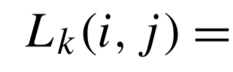
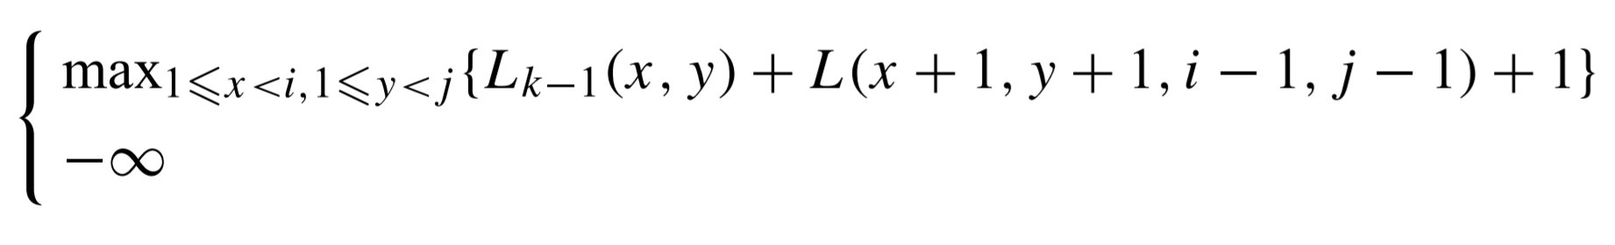


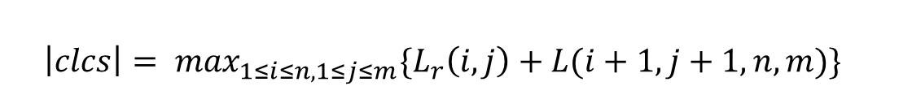

Algorithm
$L(x,y,x^{′},y^{′})$ be the length of LCS of strings $S_{1}\left[x…x^{′}\right] and$
$S_{2}\left[y…y^{′}\right] if$ $1≤x≤x^{′}≤$n and $1≤y≤y^{′}≤$m
For $2≤k≤r , 1≤i≤n , and 1≤ j≤m ,$
$$\left|clcs\right|= \max_{1≤i≤n,1≤j≤m}\{L_{r}\left(i, j\right)+L(i+1,j+1,n,m)\}$$

Slide 6

Algorithm
P = CBB , $S_{1}\left[11\right]=S_{2}\left[11\right]=$ P[3]
${ L}_{3} (11, 11)$ = ${\max{ \{}L}_{2} (8, 4)$ + L (9, 5, 10, 10) + 1 = 6 ,
$L_{2 }\left(8, 2\right)$ + L (9, 3, 10, 10) + 1 = 5 }
= 6
 | 1 | 2 | 3 | 4 | 5 | 6 | 7 | 8 | 9 | 10 | 11 | 12
S₁ | A | B | A | A | D | A | C | B | A | A | B | C
S₂ | C | B | C | B | D | A | A | D | C | D | B | A

Slide 7
Algorithm
P = CBB , $S_{1}\left[11\right]=S_{2}\left[11\right]=$ P[3]
${ L}_{3} (11, 11)$ = ${\max{ \{}L}_{2} (8, 4)$ + L (9, 5, 10, 10) + 1 = 6 ,
$L_{2 }\left(8, 2\right)$ + L (9, 3, 10, 10) + 1 = 5 }
= 6
 | 1 | 2 | 3 | 4 | 5 | 6 | 7 | 8 | 9 | 10 | 11 | 12
S₁ | A | B | A | A | D | A | C | B | A | A | B | C
S₂ | C | B | C | B | D | A | A | D | C | D | B | A

Slide 8

Time Complexity
Preprocessing Step : $L\left({x,y,x}^{′}, y^{′}\right)→O(n^{2}m^{2})$
All ${ L}_{k}\left(i, j\right) → O(rn^{2}m^{2})$
| clcs | $→ O(nm)$
$$∴ O\left(n^{2}m^{2} + rn^{2}m^{2} +nm\right)=O(rn^{2}m^{2})$$

